Slide 1
Version Date: 6Jul2021
Taste Alteration Care Pathway
Prevention
Prevention
No standard approaches to prevention
Assessment
Assess routinely using SSPedi
Assessment
Mild Bother
(SSPedi score = a little)
Moderate Bother
(SSPedi score = medium)
Severe Bother
(SSPedi score = a lot or extremely)
Allocate resources based on severity of bother and according to the preferences and capabilities of the patient
Treatment and Resources
Treatment
Provide dietary counseling and assistance with additional seasoning of food, avoiding unpleasant food and expanding dietary options
Consult clinical nutrition services

Slide 2
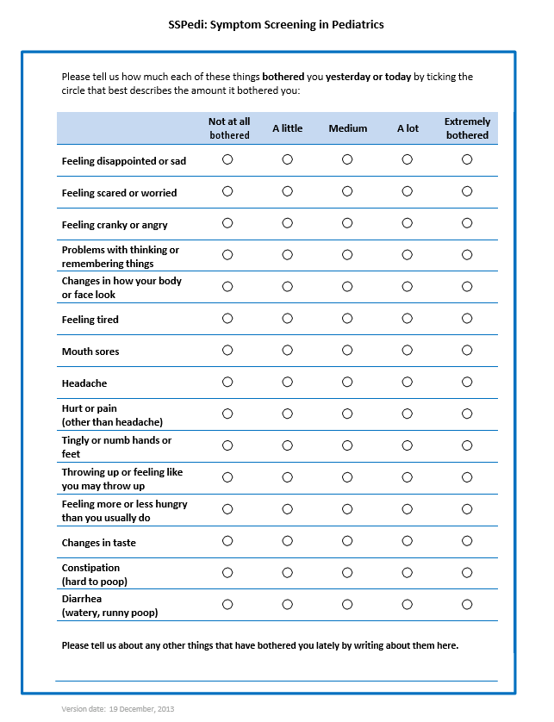
Version Date: 6Jul2021
Care Pathway

