Slide 1
Version Date: 6Jul2022
Peripheral Neuropathy Care Pathway
Prevention
Prevention
No standard approaches to prevention
Assessment
Assess routinely using SSPedi
Assessment
Mild Bother
(SSPedi score = a little)
Moderate Bother
(SSPedi score = medium)
Severe Bother
(SSPedi score = a lot or extremely)
Allocate resources based on severity of bother and according to the preferences and capabilities of the patient
Treatment and Resources
Neuropathy
Consult occupational therapy or physiotherapy as indicated
Neuropathic Pain
Initial Therapy
Consider non-pharmacological treatments such as physical and psychological therapies
Consult physiotherapy, occupational therapy, psychiatry, psychology, social work or child life services
Use amitriptyline, duloxetine, gabapentin or pregabalin as initial treatment for neuropathic pain
Ongoing Management
If initial treatment is not effective or not tolerated, use one of the other three initial agents
Repeat if necessary
Treatment
If new treatment for neuropathic pain is started, ensure overlap with old treatment to maintain pain control during transition
When discontinuing treatment, taper doses to avoid withdrawal symptoms
Consider using capsaicin cream for localized neuropathic pain for patients who wish to avoid or who cannot tolerate oral treatments
Consult pain service, anesthesia, palliative care, physiotherapy, integrative therapy, psychiatry, psychology, social work or child life services
Consult supportive service as indicated
Do not use to treat neuropathic pain: cannabis sativa extract, capsaicin patch, lacosamide, lamotrigine, levetiracetam, morphine, oxcarbazepine, sodium valproate, topiramate, tramadol or venlafaxine

Slide 2
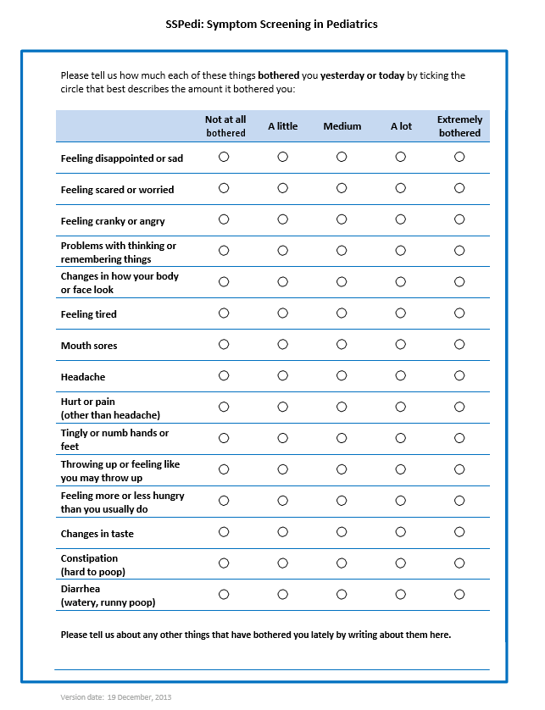
Version Date: 6Jul2022
Care Pathway

