Slide 1
Version Date: 31Aug2022
Pain Care Pathway
Prevention
No standard approaches to prevent chronic or neuropathic pain
Patients and their parents should be educated and given options
for oncologic procedures:
Prevention
Blood Sampling and Venous/Port Access
Lumbar Puncture Procedures
Bone Marrow Aspiration and Biopsies
Assessment
Assess routinely using SSPedi
Assessment
Mild Bother
(SSPedi score = a little)
Moderate Bother
(SSPedi score = medium)
Severe Bother
(SSPedi score = a lot or extremely)
Allocate resources based on severity of bother and according to the preferences and capabilities of the patient
Treatment and Resources
Consult supportive service as indicated
Consult pain service, anesthesia, palliative care, physiotherapy, integrative therapy, psychiatry, psychology, social work or child life services
Acute
Pain
Use heat/cold, topical anesthetics, acetaminophen or opioids with an aim to optimize pain control and minimize opioid exposure
Follow institutional standards
Chronic Pain
Consider physical therapy, psychological management (face-to-face or remote) or pharmacologic therapy either alone or in combination
Treatment
Consider using NSAID or acetaminophen if no contraindications exist
Consider using topical analgesics or topical anesthetics
Consider a trial of opioids in carefully selected patients with chronic pain who do not respond to non-opioid options
If opioids are no longer warranted, taper to avoid abstinence syndrome
Do not use corticosteroids to manage chronic pain
Neuropathic Pain
Follow peripheral neuropathy care pathway

Slide 2
Version Date: 31Aug2022
Pain Care Pathway
Blood Sampling and Venous/Port Access
Lumbar Puncture Procedures
Bone Marrow Aspiration and Biopsies
Use topical anesthetic
If additional interventions are required,
use active distraction (such as playing a computer game) or hypnosis
consider passive distraction (such as listening to music) instead
consult psychology or child life services
Suggest sedation or oral analgesia not be routinely used
Use topical anesthetic and offer deep sedation or general anesthesia
For those who cannot undergo, or do not wish deep sedation/general anesthesia, use topical anesthetic and
use active distraction (such as playing a computer game) or hypnosis
consider passive distraction (such as listening to music) instead
consult psychology or child life services
Use topical anesthetic and deep sedation or general anesthesia
For those who cannot undergo, or do not wish deep sedation/general anesthesia, use topical anesthetic and
use active distraction (such as playing a computer game) or hypnosis
consider passive distraction (such as listening to music) instead
consult psychology or child life services

Slide 3
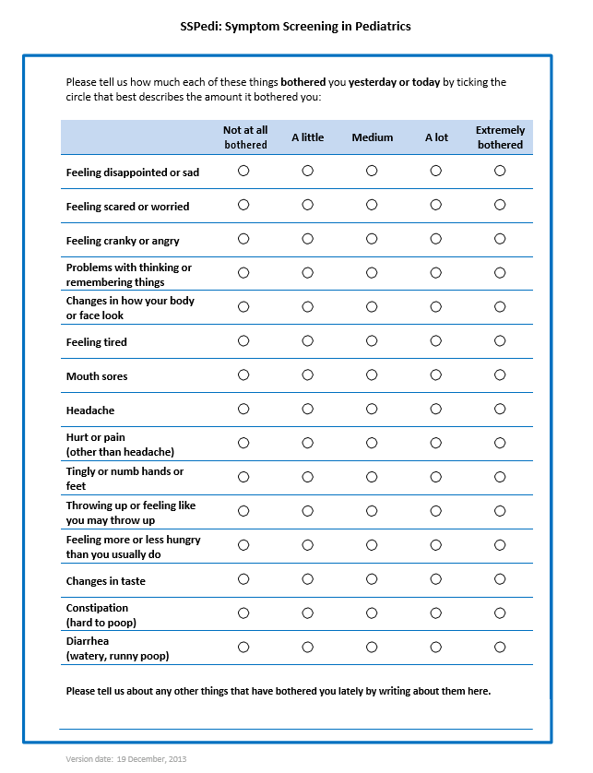
Version Date: 31Aug2022
Care Pathway

