Slide 1
Version Date: 3Dec2020
Lumbar Puncture Pain Care Pathway
Prevention
Prevention
Use atraumatic (pencil point) rather than conventional needles
Pain care pathway
Assessment
Assessment
Assess pain routinely using SSPedi
Treatment
Treatment
Post-procedural pain
Pain care pathway

Slide 2
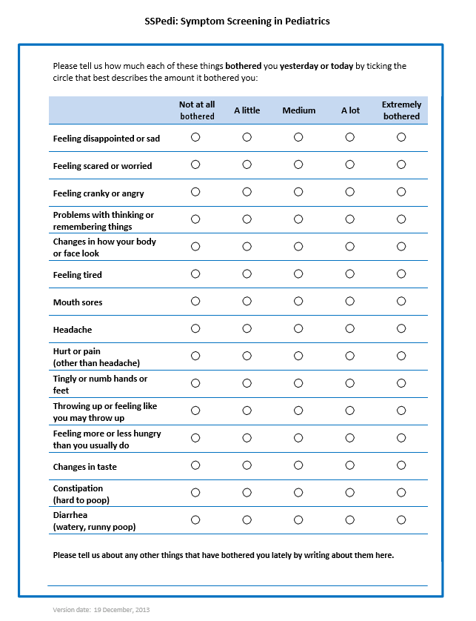
Version Date: 3Dec2020
Care Pathway

