Slide 1
Version Date: 6Jul2021
Constipation Care Pathway
Prevention
Prevention Options
Prevention
Encourage age-appropriate fluid and dietary fiber intake
Promote routine physical activity
Assessment
Evaluate stool patterns routinely
Assess routinely using SSPedi
Assessment
Mild Bother
(SSPedi score = a little)
Moderate Bother
(SSPedi score = medium)
Severe Bother
(SSPedi score = a lot or extremely)
Allocate resources based on severity of bother and according to the preferences and capabilities of the patient
Treatment and Resources
Encourage age-appropriate fluid and dietary fiber intake
Consider consulting clinical
nutrition services
Increase physical activity
Consider consulting physiotherapy, occupational therapy or child life services
Use polyethylene glycol (PEG) 3350 + electrolytes
If non-severe constipation or after treatment for severe constipation, use PEG 3350 + electrolytes and adjust the dose according to symptoms and response
If severe constipation, use PEG 3350 + electrolytes using an escalating dose regimen
Treatment
If not effective, add a stimulant laxative such as bisacodyl, senna or sodium picosulfate
If stools are hard, add another laxative such as docusate or lactulose
If PEG 3350 + electrolytes is not tolerated, substitute a stimulant laxative
If not effective after 1-3 days, add a stimulant laxative such as bisacodyl, senna or sodium picosulfate
If PEG 3350 + electrolytes is not tolerated, use a stimulant laxative alone or in combination with an osmotic laxative such as lactulose
Do not:
use dietary intervention alone as the initial treatment for constipation
recommend unprocessed bran as it may reduce absorption of micronutrients
routinely use rectal medications, sodium citrate enemas or phosphate enemas
routinely perform manual evacuation of the bowel

Slide 2
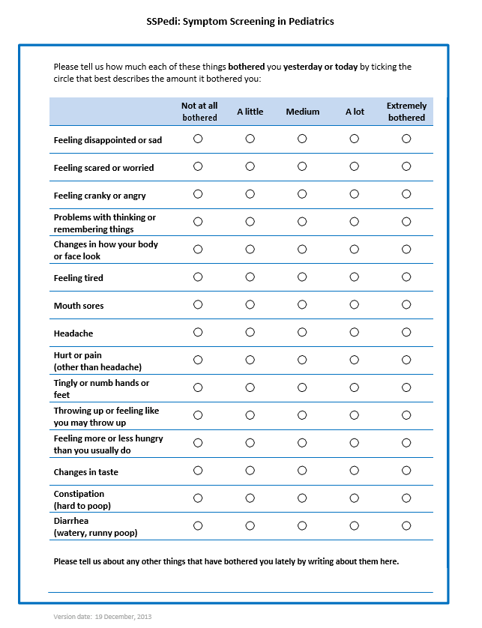
Version Date: 6Jul2021
Care Pathway

