Slide 1
Version Date: 6Jul2021
Cognition Alteration Care Pathway
Prevention
No standard approaches to prevention
Prevention
Assessment
Assess routinely using SSPedi
Assessment
Moderate Bother
(SSPedi score = medium)
Severe Bother
(SSPedi score = a lot or extremely)
Mild Bother
(SSPedi score = a little)
Allocate resources based on severity of bother and according to the preferences and capabilities of the patient
Treatment and Resources
Address reversible contributing factors including fatigue, insomnia, depression
and medications
Treatment
Consult neuropsychologic and rehabilitation services as indicated
Consult neurology, psychiatry, psychology, occupational therapy or physical medicine and rehabilitation services

Slide 2
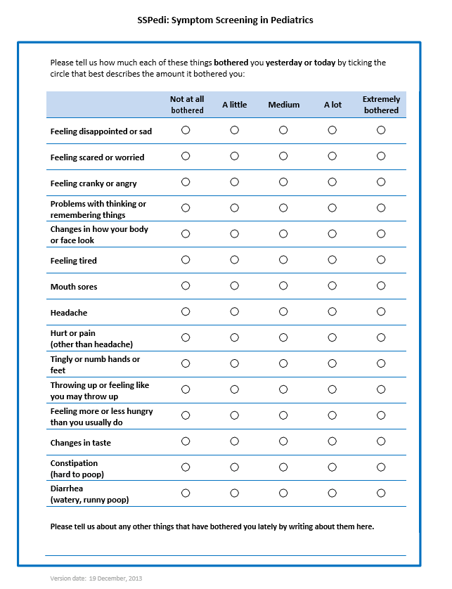
Version Date: 6Jul2021
Care Pathway

