Slide 1
Version Date: 6Jul2021
Body Image Care Pathway
Prevention Options
Prevention
Consider consulting a mental health specialist for patients at risk of bother due to expected changes in physical appearance
Consult psychiatry, psychology or social work
Prevention
Assessment
Assess routinely using SSPedi
Assessment
Mild Bother
(SSPedi score = a little)
Moderate Bother
(SSPedi score = medium)
Severe Bother
(SSPedi score = a lot or extremely)
Allocate resources based on severity of bother and according to the preferences and capabilities of the patient
Treatment and Resources
Consult psychiatry, psychology, social work, art therapy, chaplaincy, child life services, music therapy or recreational therapy
Encourage peer support groups
Consult psychosocial resource
Treatment
Offer adaptive devices such as prostheses or wigs
Follow institutional standards

Slide 2
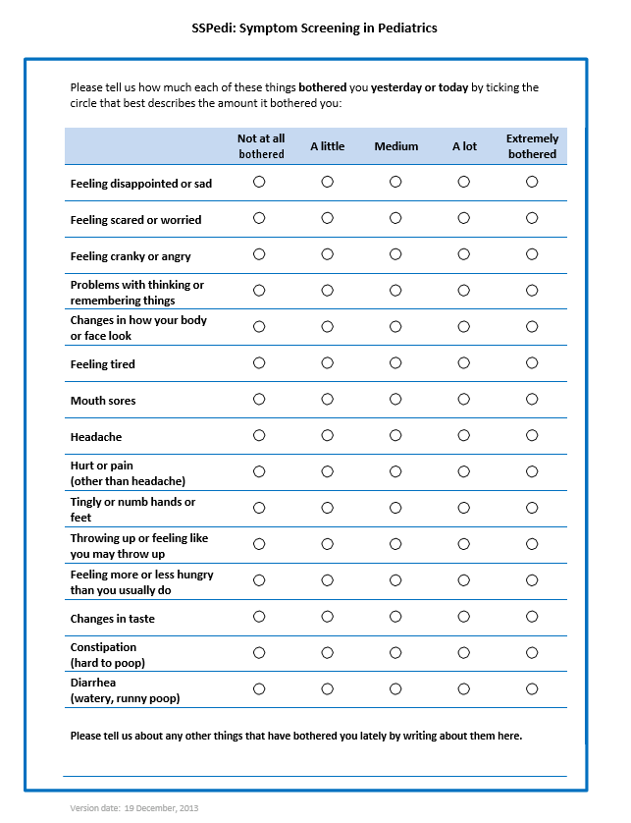
Version Date: 6Jul2021
Care Pathway

