Slide 1
Version Date: 6Jul2021
Anxiety Care Pathway
Prevention
Encourage patient to share their feelings and concerns
Prevention
Assessment
Assess routinely using SSPedi
Assessment
Moderate Bother
(SSPedi score = medium)
Mild Bother
(SSPedi score = a little)
Severe Bother
(SSPedi score = a lot or extremely)
Allocate resources based on severity of bother and according to the preferences and capabilities of the patient
Treatment and Resources
Consult psychiatry, psychology, social work, art therapy, chaplaincy, child life services, music therapy or recreational therapy
Encourage peer support groups
Consult psychosocial resource
Treatment
Do not give a benzodiazepine for the routine treatment of anxiety
Only give as a short-term measure for crisis treatment

Slide 2
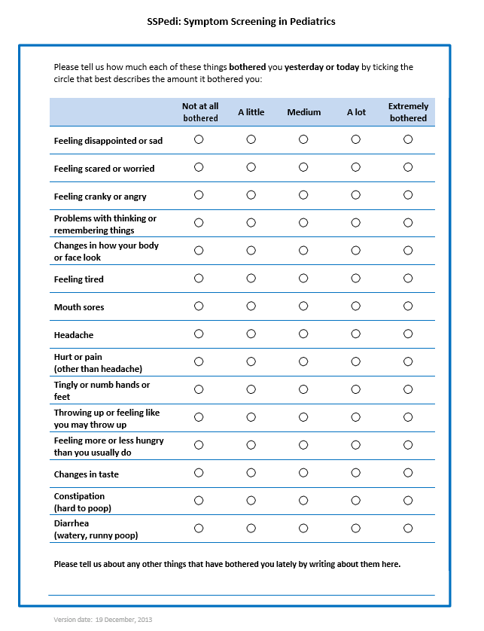
Version Date: 6Jul2021
Care Pathway

